Slide 1

ANGULAR COURSE
TypeScript Fundamentals
VTI ACADEMY
Author: Tống Minh Giang
May 2020

Slide 2
Nội dung
Nhập môn JavaScript và TypeScript.
Data type, Operators, Variables, Scope, Program Structure.
Function, Higher-Order Function, Object/Class, Array.
Asynchronous Programming, Events, Block scope variables, Constant.
Arrow functions, Default parameter value, Rest, Spread, Class, Module.
Promise, Async/Await.

Slide 3
Mục tiêu
Hiểu được các khái niệm cơ bản trong lập trình ứng dụng với JavaScript và TypeScript.

Slide 4
Yêu cầu chung
Đã có hiểu biết về HTML, CSS
Phần mềm:
Nodejs
TypeScript
Editor: VS Code, Atom, Sublime Text, WebStorm, Vim, etc

Slide 5
ES5 ES2015+ TypeScript

Slide 6
Data type, Operators, Variables, Scope,
Program Structure

Slide 7
Data Type
Primitive Values.
Objects.

Slide 8
Primitive Values
Boolean: true/false
Number: 10, 3.14, …
String: ‘abc’, …
Null
Undefined
Symbol (ES2015)
Note: You can’t define your own primitive types.

Slide 9
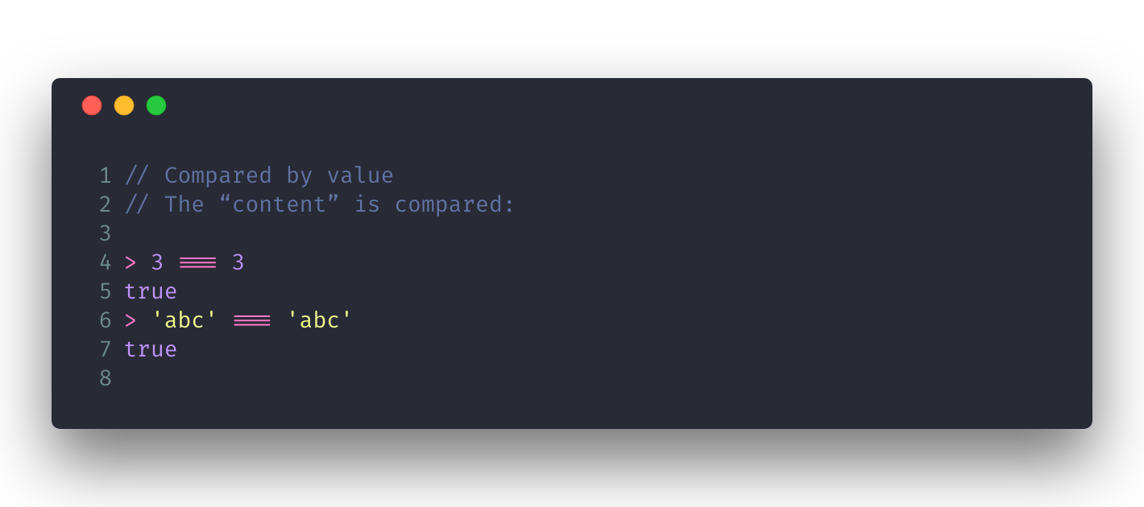
Primitive Values
Compared by value

Slide 10
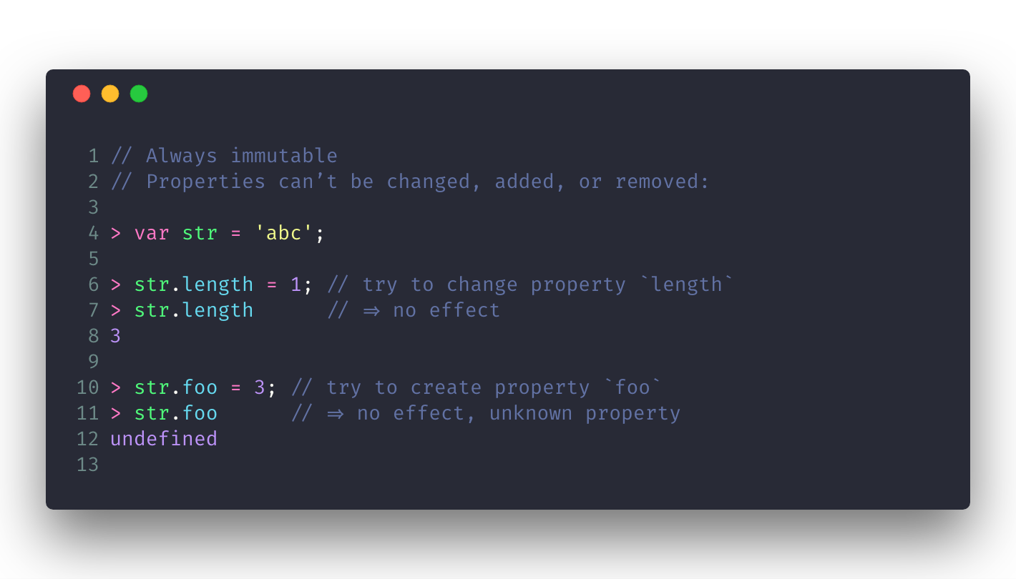
Primitive Values
Always immutable

Slide 11
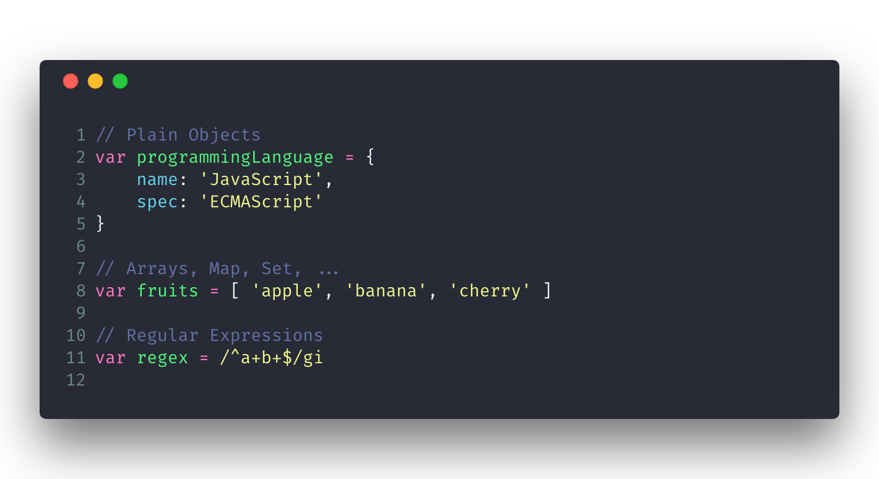
Objects
All nonprimitive values are objects.

Slide 12
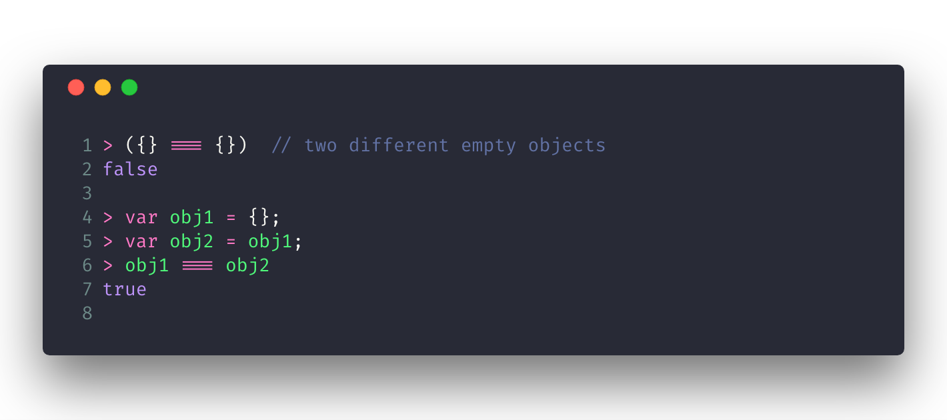
Objects
Compared by reference

Slide 13
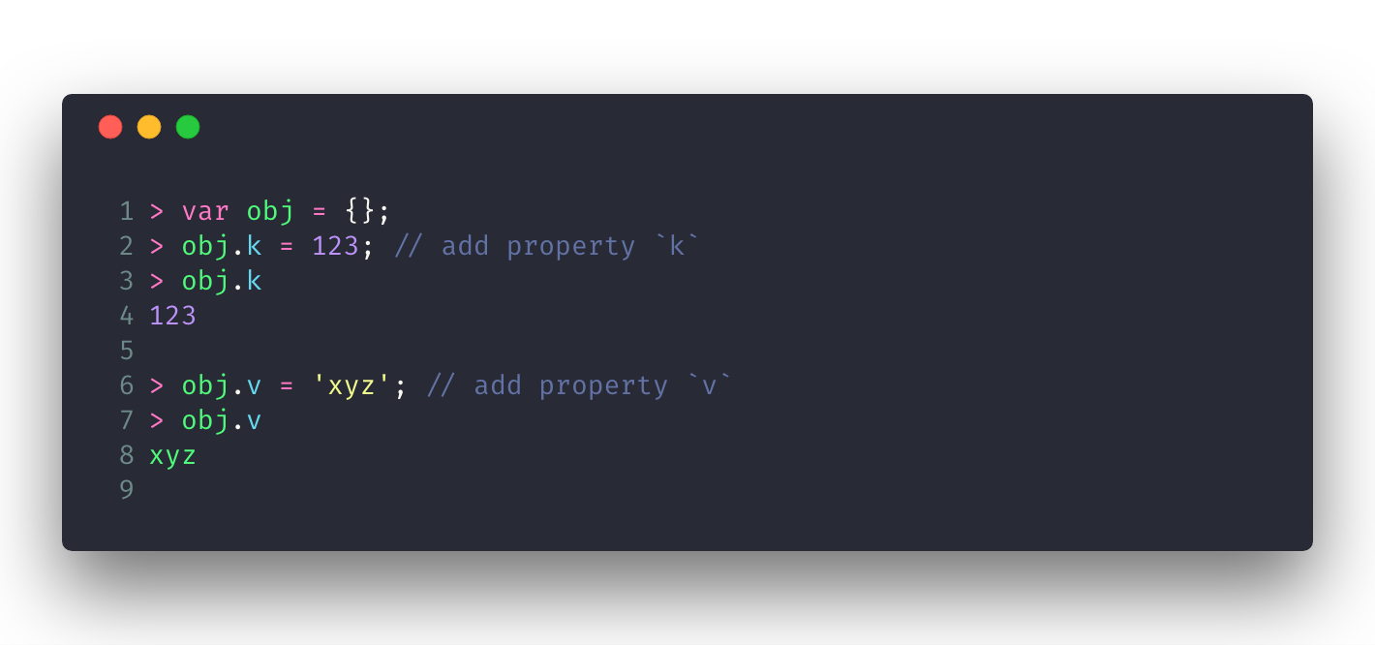
Objects
Mutable by default

Slide 14
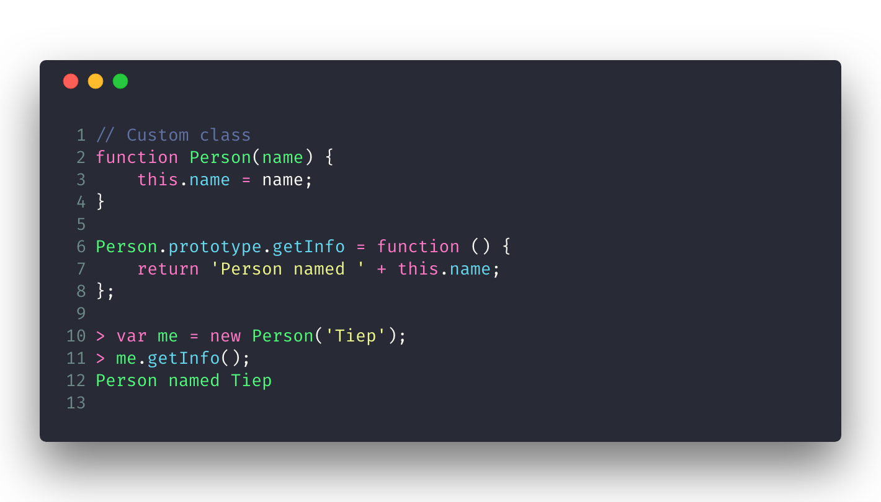
Objects
User-extensible

Slide 15
Null and Undefined
undefined means “no value” (neither primitive nor object).
Uninitialized variables
Missing parameters
Missing properties have that nonvalue
Functions implicitly return it if nothing has been explicitly returned.
null means “no object.” It is used as a nonvalue where an object is expected (as a parameter, as a member in a chain of objects, etc.).

Slide 16
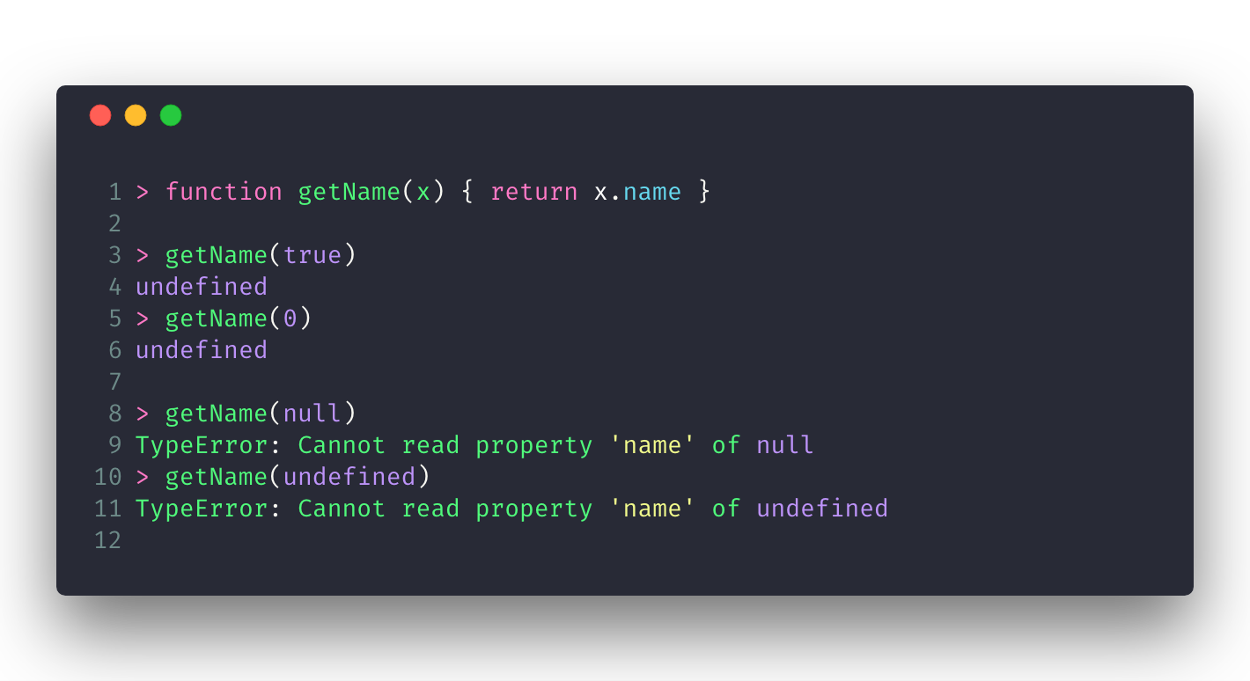
Null and Undefined
undefined and null are the only values for which any kind of property access results in an exception.

Slide 17
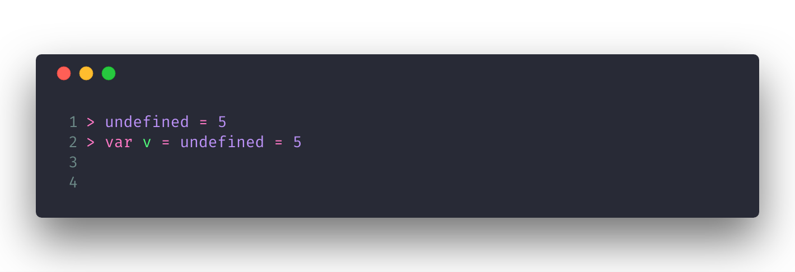
Null and Undefined
undefined is not a keyword in JavaScript.

Slide 18
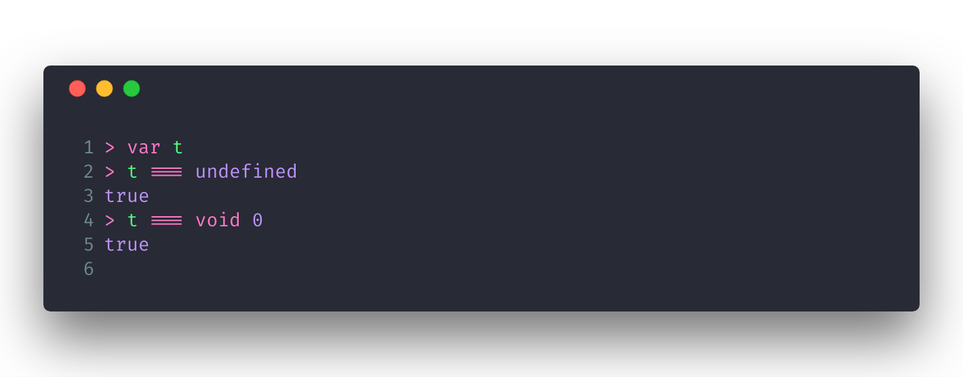
Null and Undefined
undefined is not a keyword in JavaScript.

Slide 19
Wrapper Objects for Primitives
Boolean
Number
String

Slide 20
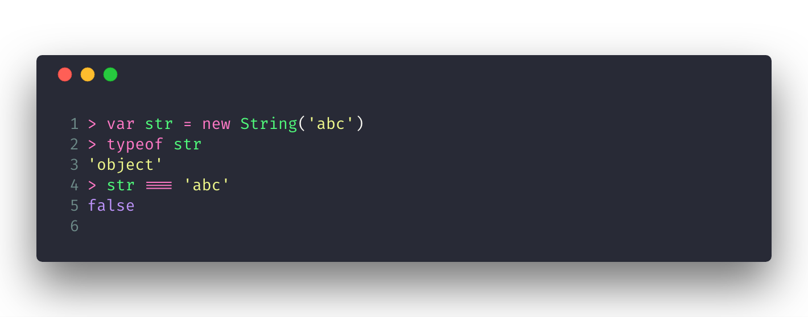
Wrapper Objects for Primitives
As constructors, they create objects that are largely incompatible with the primitive values that they wrap

Slide 21
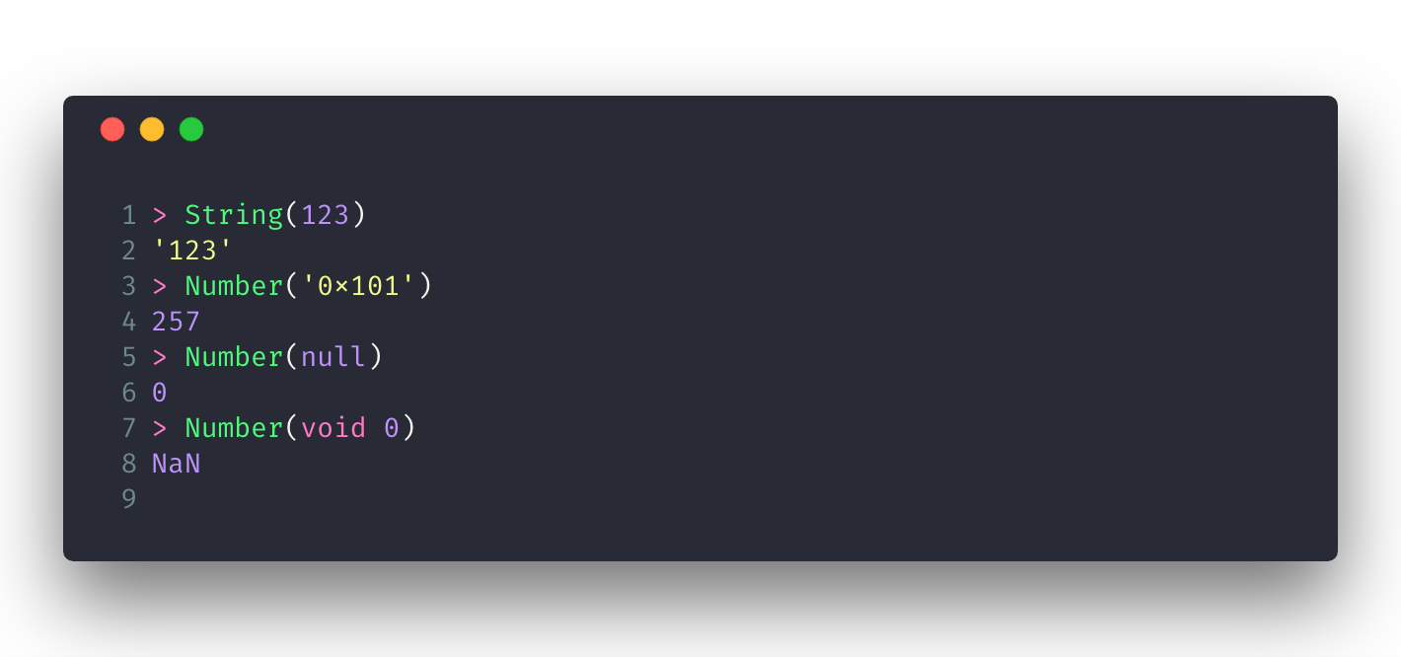
Wrapper Objects for Primitives
As functions, they convert values to the corresponding primitive types

Slide 22
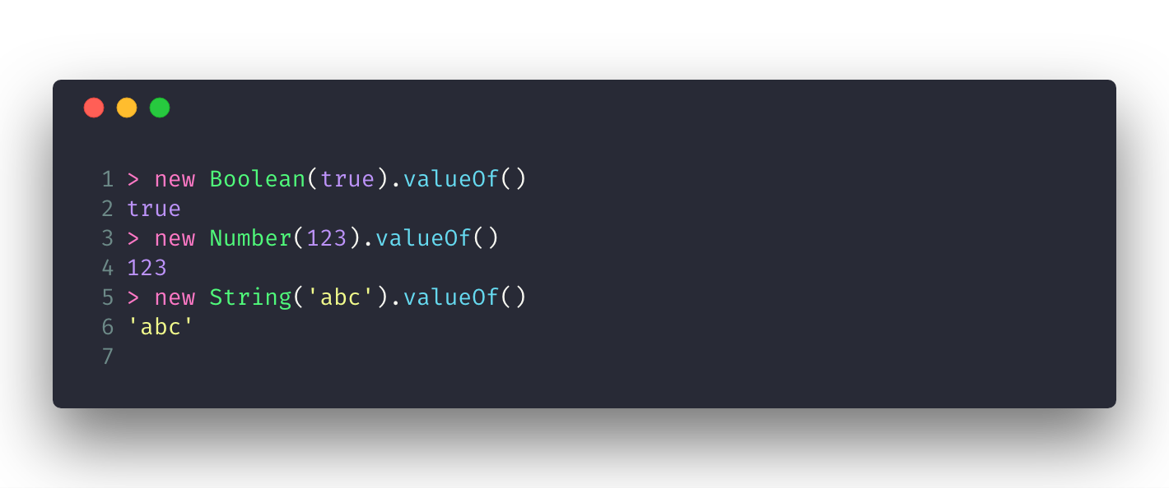
Un-wrapping Primitives
Unwrap a primitive by invoking the method valueOf(). All objects have this method.

Slide 23
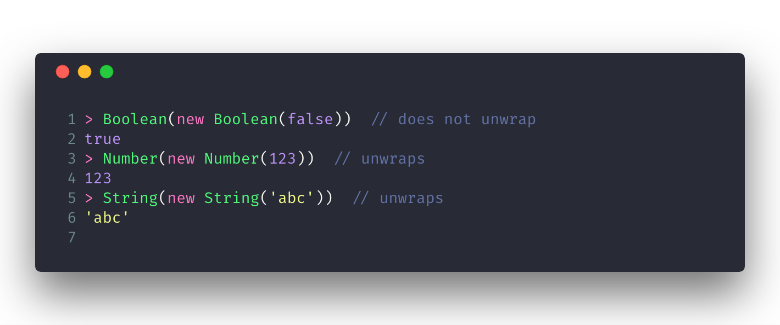
Un-wrapping Primitives
Converting wrapper objects to primitives properly extracts numbers and strings, but not booleans.

Slide 24
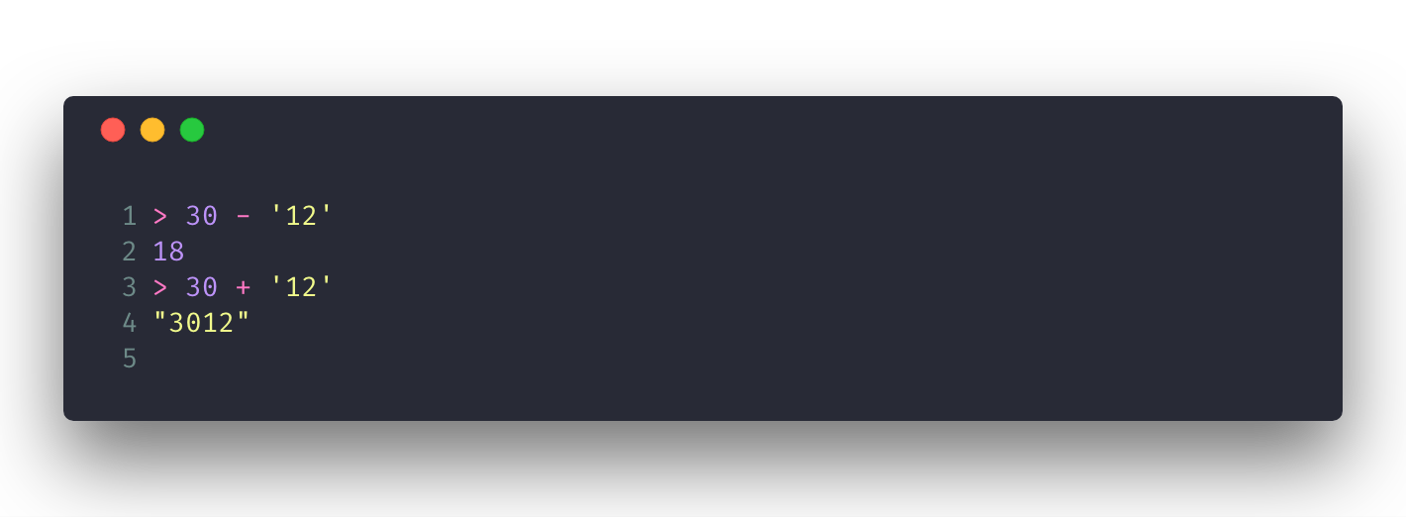
Type Coercion
Type coercion means the implicit conversion of a value of one type to a value of another type.
Most of JavaScript’s operators, functions, and methods coerce operands and arguments to the types that they need.

Slide 25
Truthy and Falsy Values
undefined, null
Boolean: false
Number: 0, NaN
String: ''
all objects are truthy

Slide 26
Operators
String operators
Conditional (ternary) operator
Comma operator
Unary operators
Relational operators
Assignment operators
Comparison operators
Arithmetic operators
Bitwise operators
Logical operators
https://developer.mozilla.org/en-US/docs/Web/JavaScript/Guide/Expressions_and_Operators

Slide 27
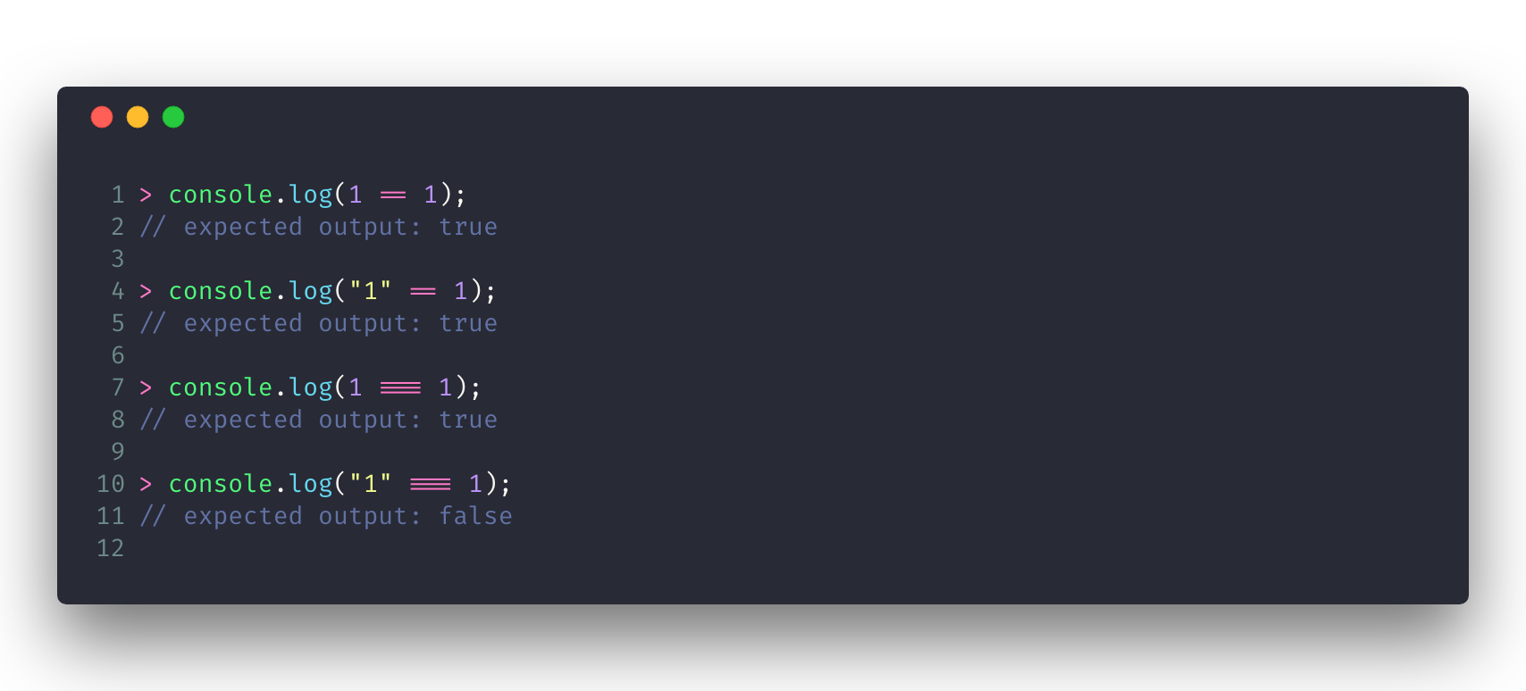
Operators

Slide 28
Operators
JavaScript Comparison Algorithms:
Two strings are strictly equal when they have the same sequence of characters, same length, and same characters in corresponding positions.
Two numbers are strictly equal when they are numerically equal (have the same number value). NaN is not equal to anything, including NaN. Positive and negative zeros are equal to one another.
https://developer.mozilla.org/en-US/docs/Web/JavaScript/Reference/Operators/Comparison_Operators

Slide 29
Operators
JavaScript Comparison Algorithms:
Two Boolean operands are strictly equal if both are true or both are false.
Two distinct objects are never equal for either strict or abstract comparisons.
An expression comparing Objects is only true if the operands reference the same Object.
Null and Undefined Types are strictly equal to themselves and abstractly equal to each other.
https://developer.mozilla.org/en-US/docs/Web/JavaScript/Reference/Operators/Comparison_Operators

Slide 30
Operators
JavaScript Comparison Algorithms - Equality Operators:
When comparing a number and a string, the string is converted to a number value.
If one of the operands is Boolean, (1 if it is true and +0 if it is false).
If an object is compared with a number or string, JavaScript attempts to return the default value for the object. Operators attempt to convert the object to a primitive value, a String or Number value, using the valueOf and toString methods of the objects. If this attempt to convert the object fails, a runtime error is generated.
https://developer.mozilla.org/en-US/docs/Web/JavaScript/Reference/Operators/Comparison_Operators

Slide 31
Operators
JavaScript Comparison Algorithms - Equality Operators:
If the valueOf method returns a primitive value, the toString method will never be called.
Note that an object is converted into a primitive if, and only if, its comparand is a primitive. If both operands are objects, they're compared as objects, and the equality test is true only if both refer the same object.
https://developer.mozilla.org/en-US/docs/Web/JavaScript/Reference/Operators/Comparison_Operators

Slide 32
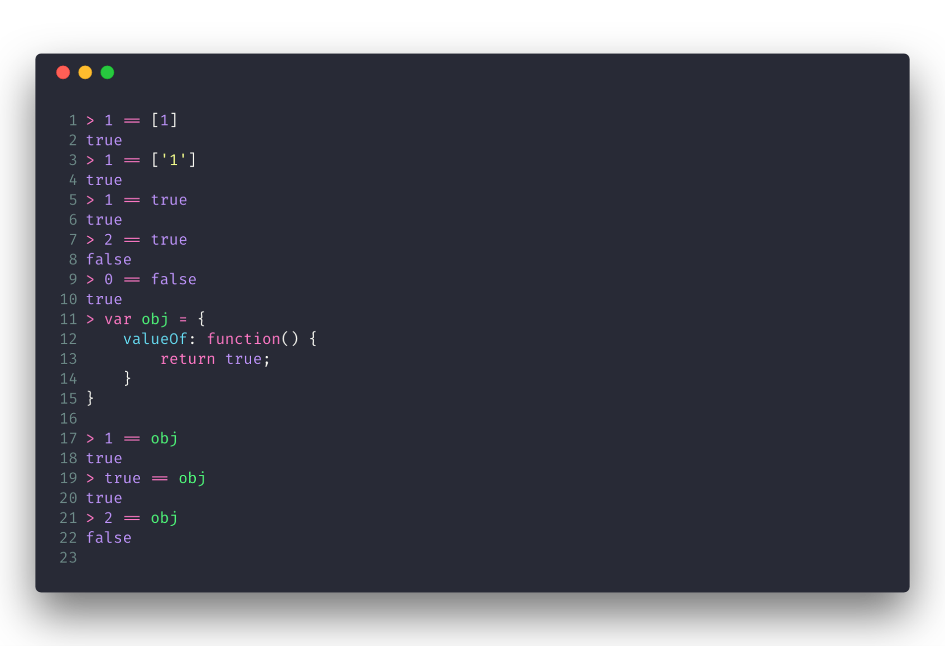
Operators
JavaScript Comparison Algorithms - Equality Operators:

Slide 33
The Plus Operator
If one of them is a string, the other is also converted to a string and both are concatenated.
Otherwise, both operands are converted to numbers and added.

Slide 34
Unary Operators
Unary plus (+): Tries to convert the operand into a number
Unary negation (-): Tries to convert the operand into a number and negates after
Logical Not (!): Converts to boolean value then negates it
Increment (++): Adds one to its operand
Decrement (--): Decrements by one from its operand
Bitwise not (~): Inverts all the bits in the operand and returns a number
typeof: Returns a string which is the type of the operand
delete: Deletes specific index of an array or specific property of an object
void: Discards a return value of an expression.

Slide 35
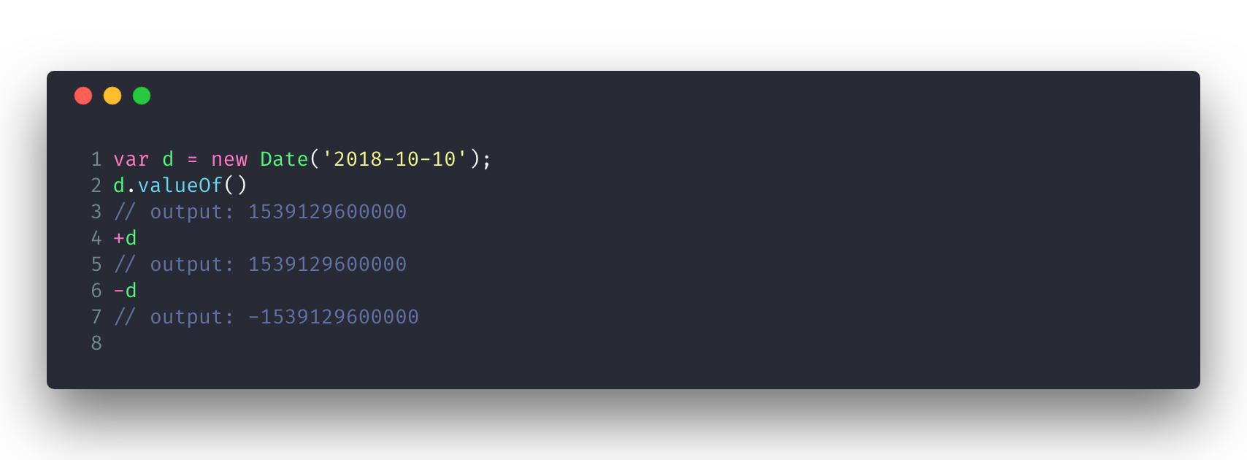
Unary Operators

Slide 36
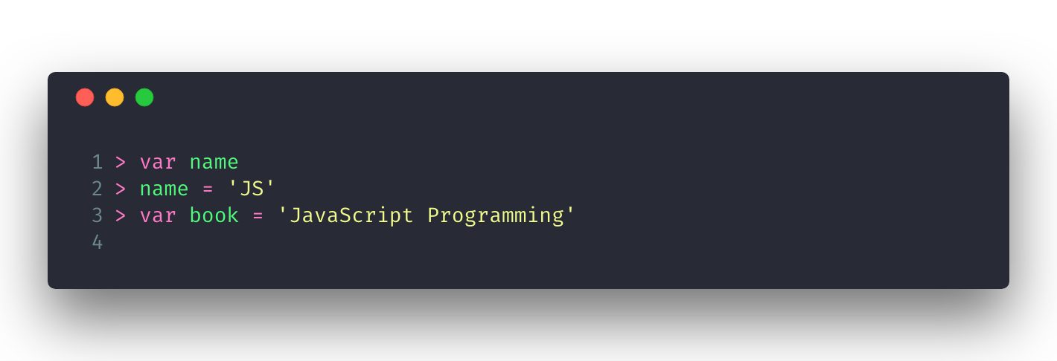
Variables, Scope
Declaring and Assigning Variables.

Slide 37
Variables, Scope
An Identifier is an IdentifierName that is not a ReservedWord.
An identifier must start with $, _, or any character in the Unicode categories “Uppercase letter (Lu)”, “Lowercase letter (Ll)”, “Titlecase letter (Lt)”, “Modifier letter (Lm)”, “Other letter (Lo)”, or “Letter number (Nl)”.
The rest of the string can contain the same characters, plus any U+200C zero width non-joiner characters, U+200D zero width joiner characters, and characters in the Unicode categories “Non-spacing mark (Mn)”, “Spacing combining mark (Mc)”, “Decimal digit number (Nd)”, or “Connector punctuation (Pc)”.

Slide 38
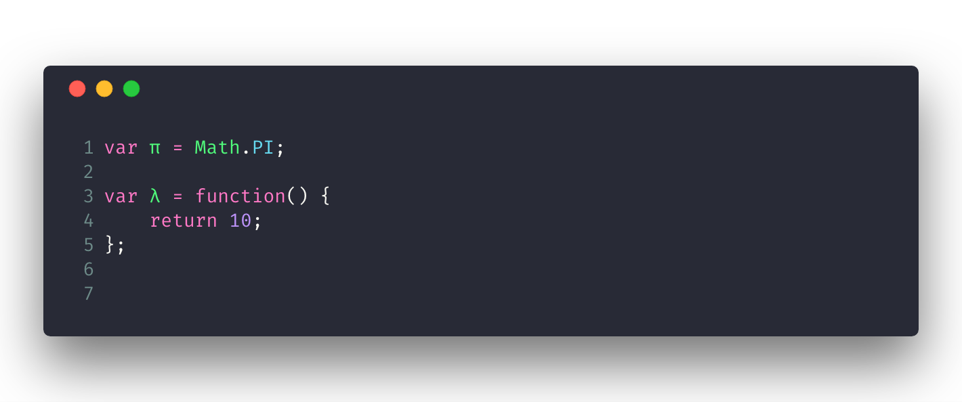
Variables, Scope
Valid Identifiers.
https://mathiasbynens.be/notes/javascript-identifiers

Slide 39
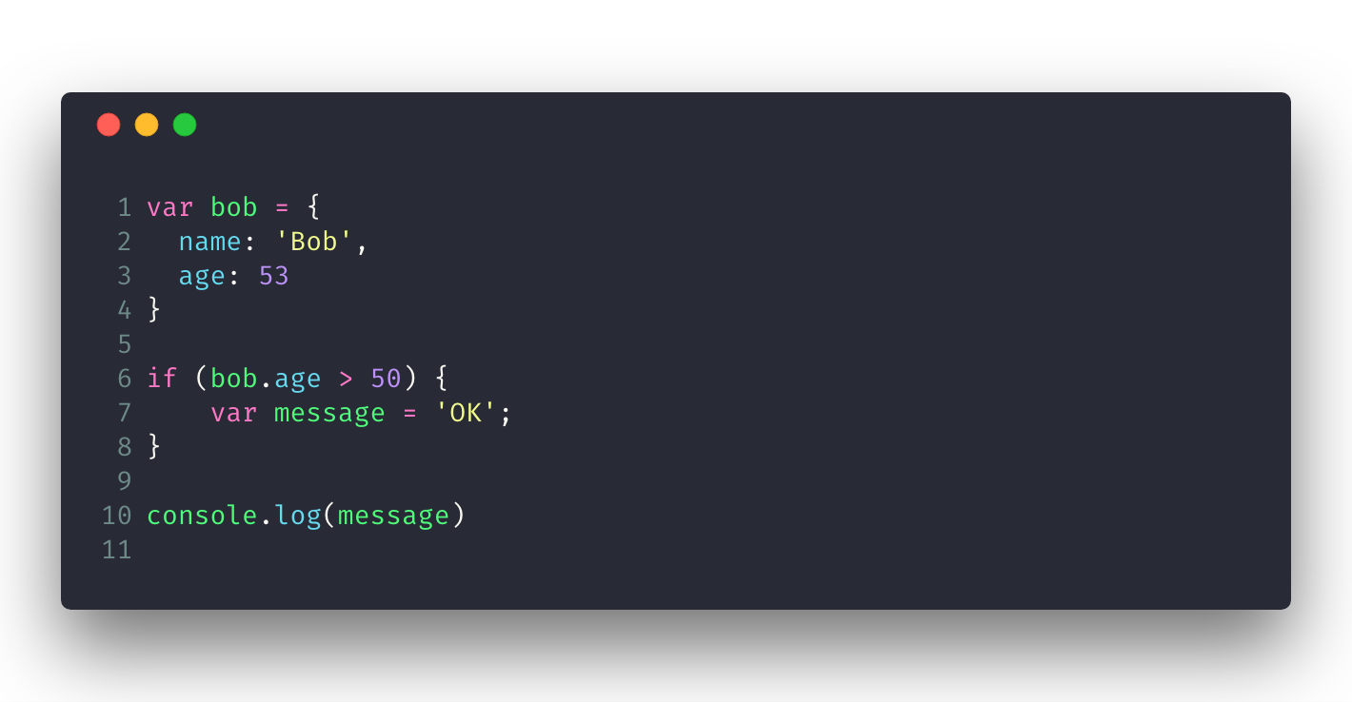
Variables, Scope
Function scope, global scope, hoisting

Slide 40
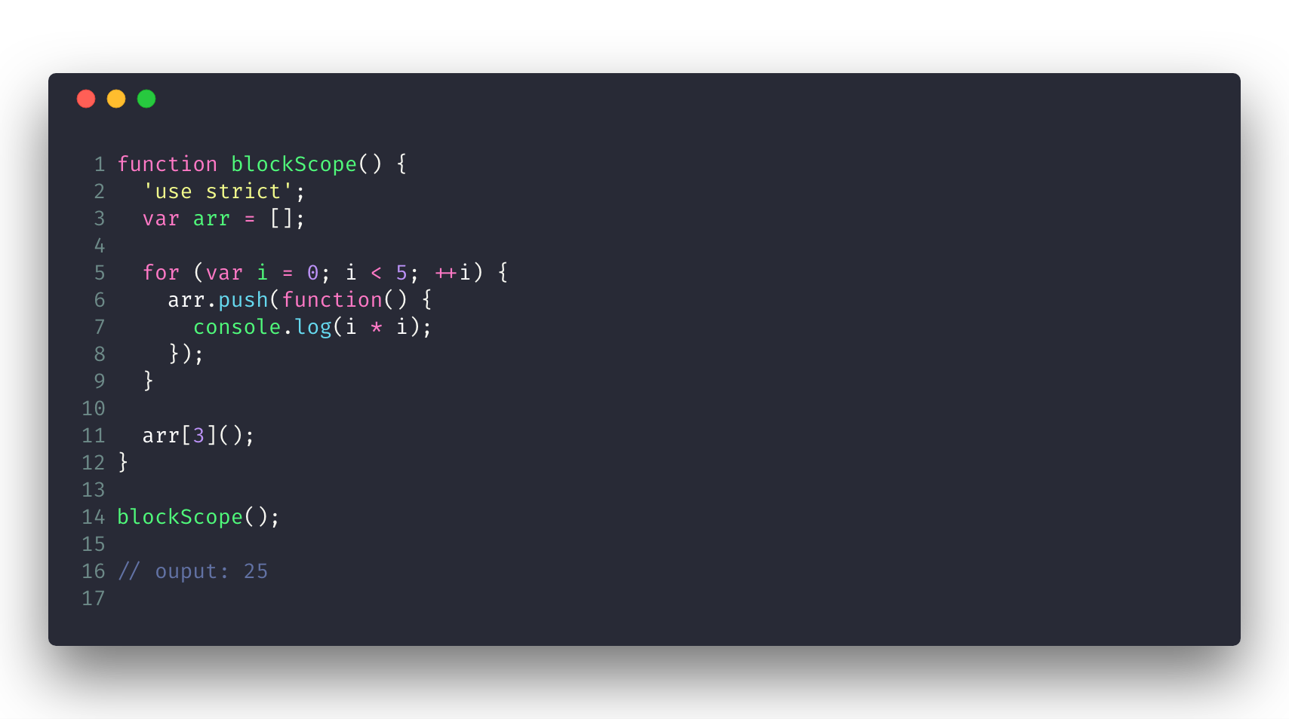
Variables, Scope
Function scope, global scope, hoisting

Slide 41
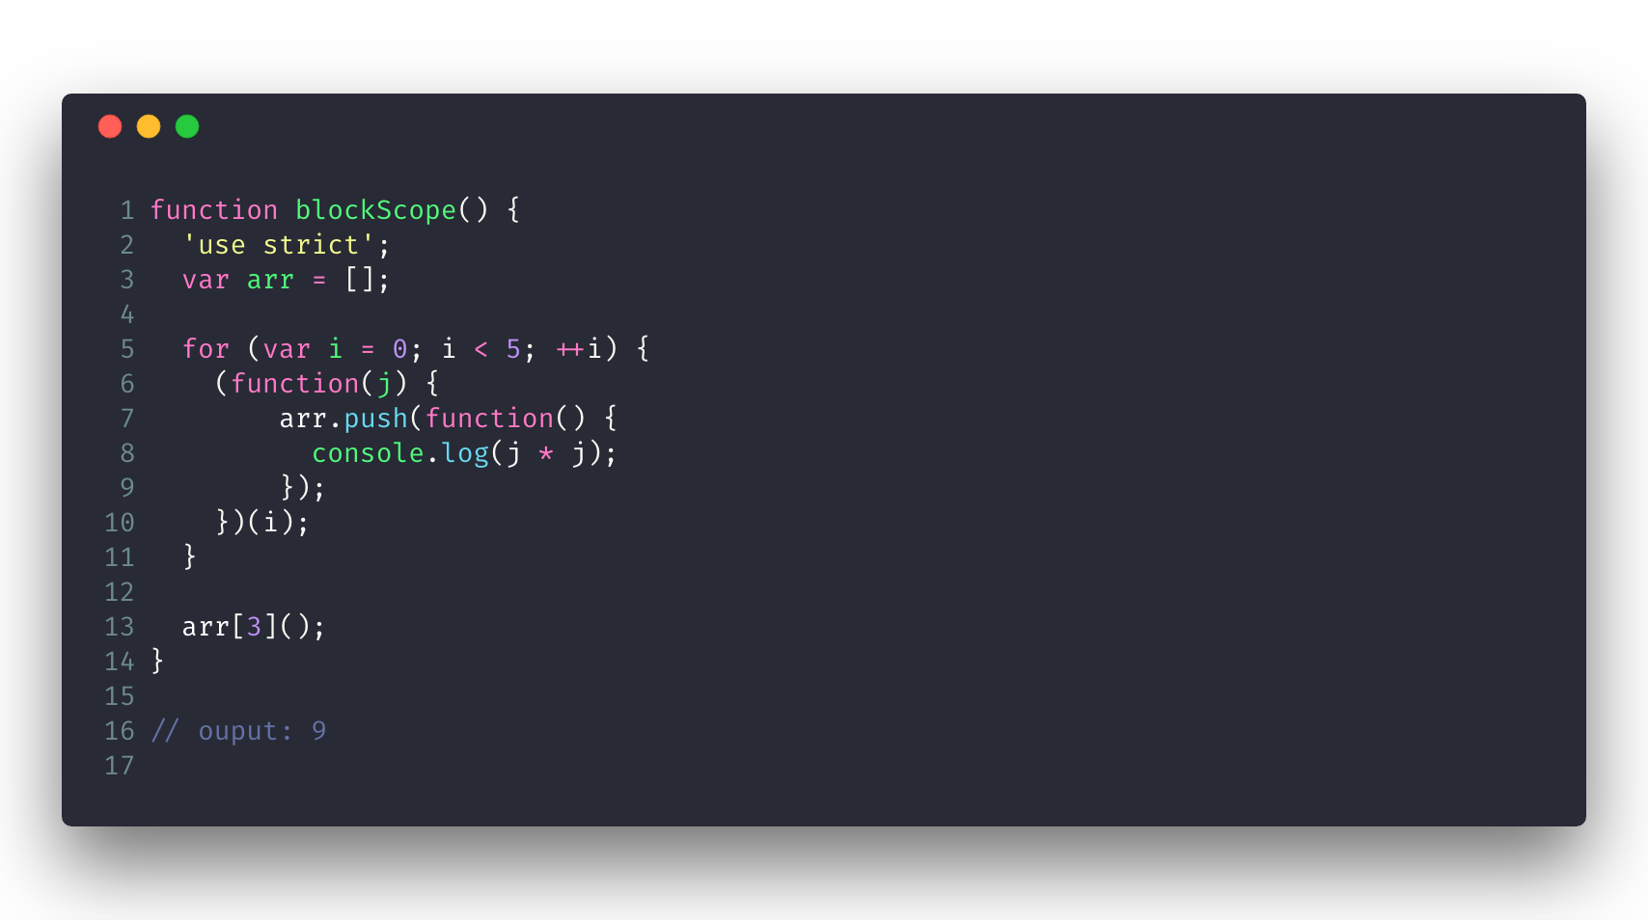
Variables, Scope
Function scope, global scope, hoisting

Slide 42
Program Structure
Conditionals: if-else, switch-case.
Loops: while, do-while, for, for-in, for-of.

Slide 43
Function, Higher-Order Function,
Object/Class, Array

Slide 44
Functions
A function is a JavaScript procedure—a set of statements that performs a task or calculates a value.
To use a function, you must define it somewhere in the scope from which you wish to call it.
44

Slide 45
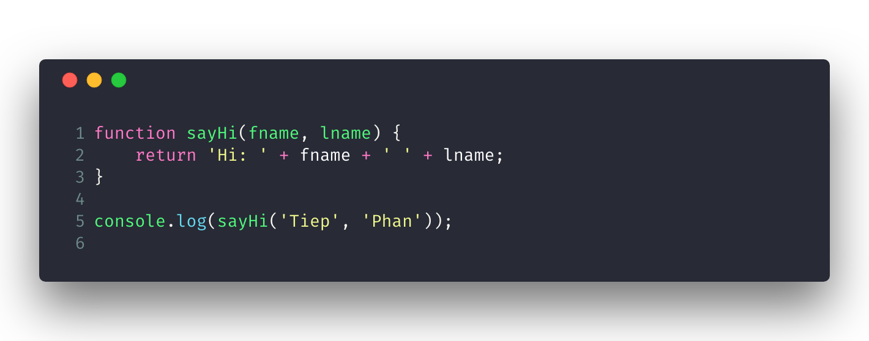
Functions

Slide 46
Functions
Function declarations: A function definition (also called a function declaration, or function statement) consists of the function keyword, followed by:
The name of the function.
A list of parameters to the function, enclosed in parentheses and separated by commas.
The JavaScript statements that define the function, enclosed in curly brackets, { }.
Function declarations are hoisted onto the beginning of the scope.

Slide 47
Functions
Function expressions: A function expression may be a part of a larger expression.
One can define "named" function expressions (where the name of the expression might be used in the call stack for example) or "anonymous" function expressions.
Function expressions are not hoisted onto the beginning of the scope, therefore they cannot be used before they appear in the code.

Slide 48
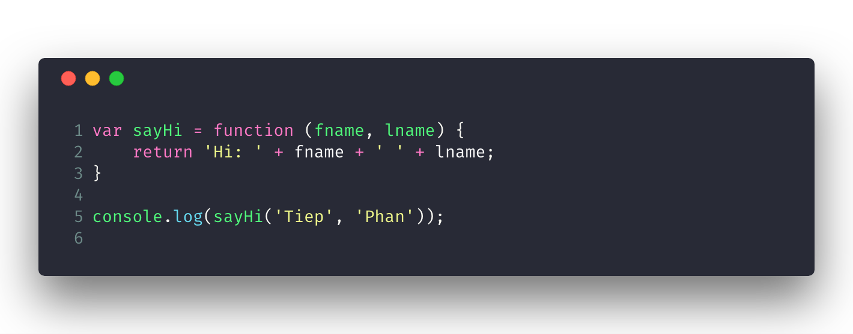
Functions

Slide 49
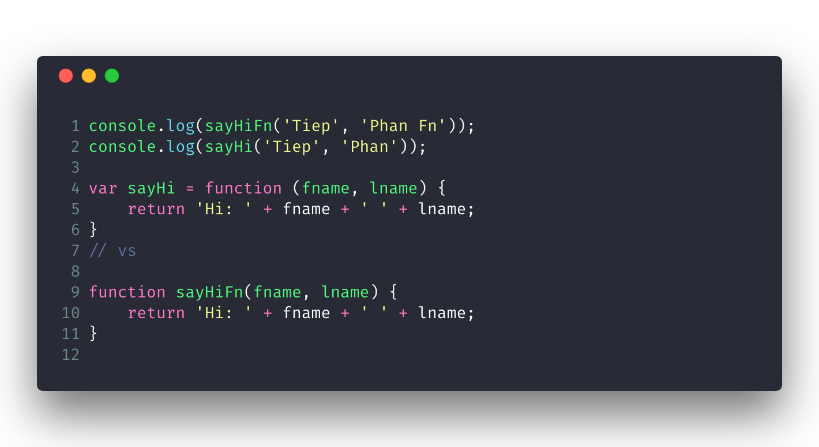
Functions

Slide 50
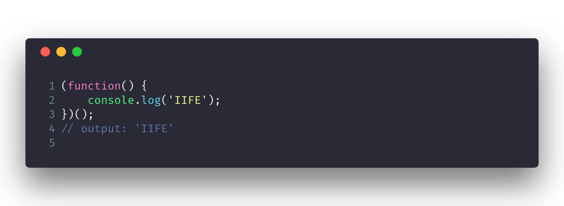
Functions
IIFE (Immediately Invokable Function Expression): function expressions that are invoked as soon as the function is declared.

Slide 51
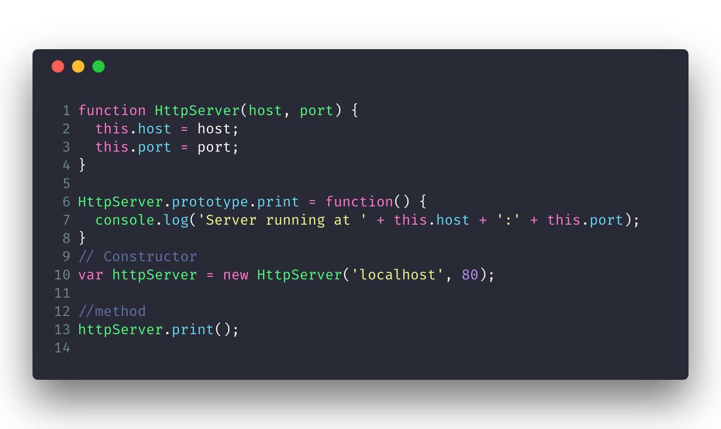
Functions
The Three Roles of Functions in JavaScript:
Non-method function (normal function).
Constructor.
Method.

Slide 52
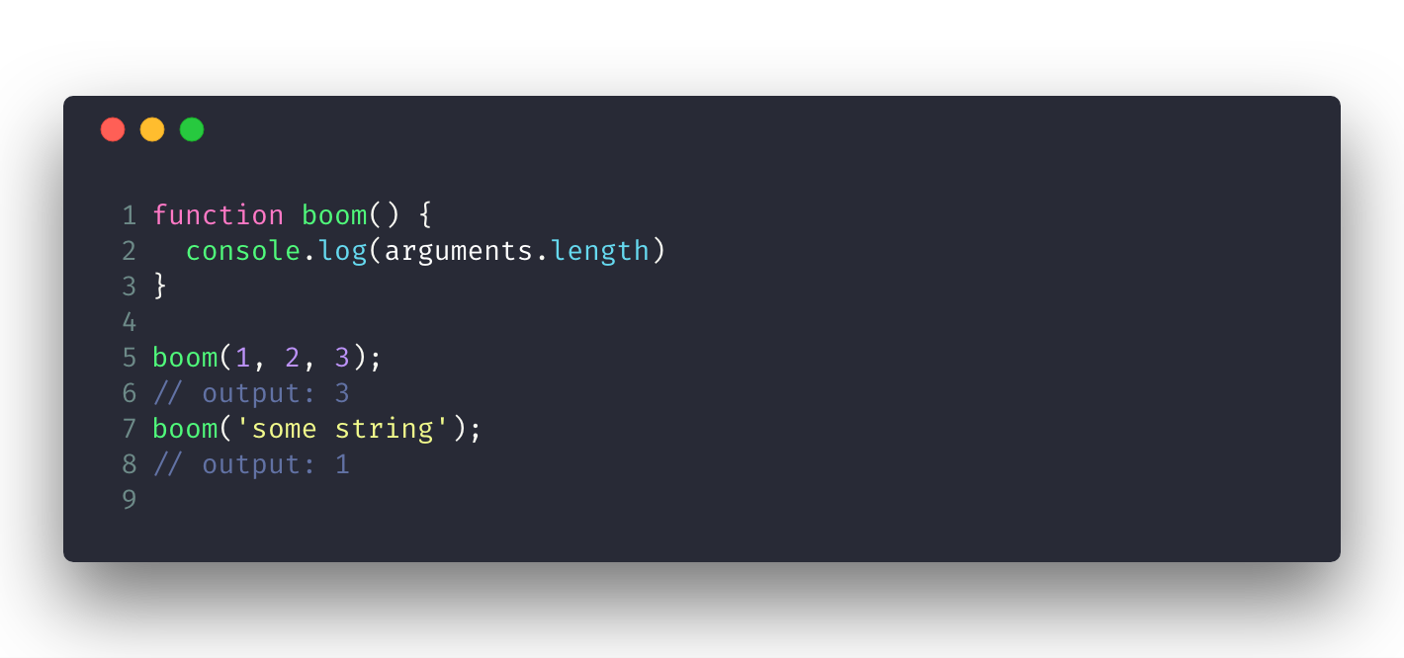
Functions
“Parameter” Versus “Argument”:
Parameters are used to define a function.
Arguments are used to invoke a function.
The arguments object: The arguments of a function are maintained in an array-like object.
Access 1st argument: arguments[0]
The total number of arguments is indicated by arguments.length

Slide 53
Closure
You can nest a function within a function. The nested (inner) function is private to its containing (outer) function.
The inner function can be accessed only from statements in the outer function.
The inner function forms a closure: the inner function can use the arguments and variables of the outer function, while the outer function cannot use the arguments and variables of the inner function.
When a function gets declared, it contains a function definition and a closure. The closure is a collection of all the variables in scope at the time of creation of the function.

Slide 54
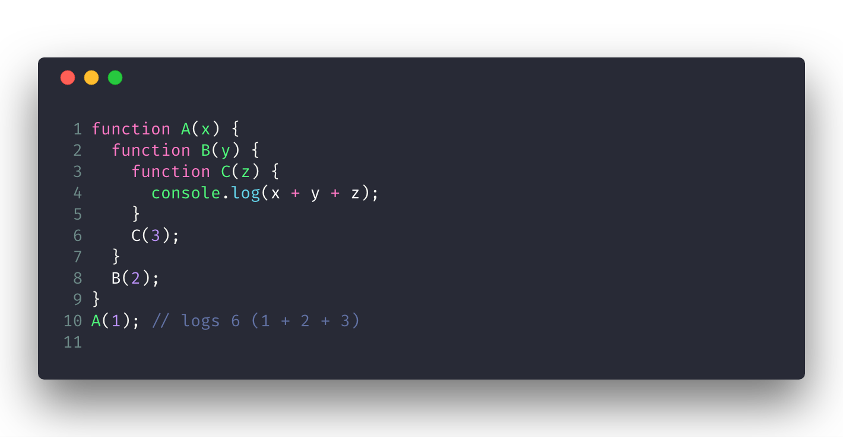
Closure

Slide 55
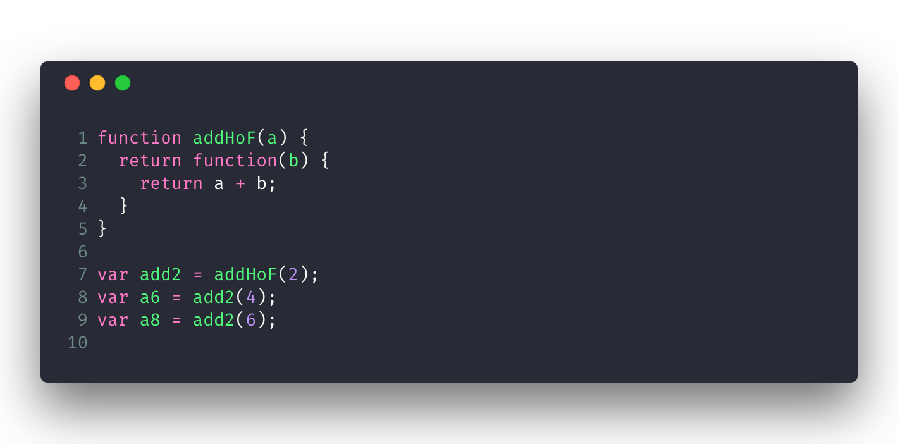
Closure

Slide 56
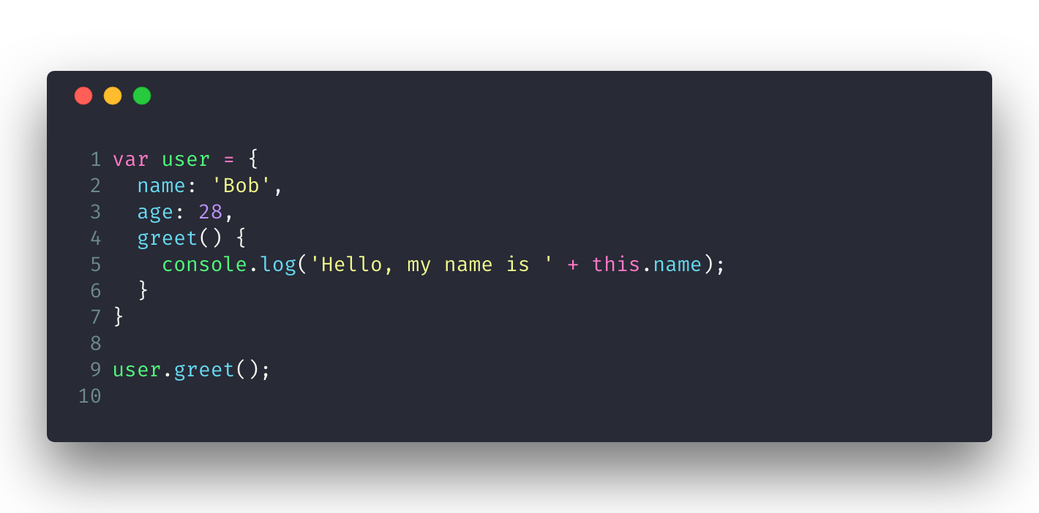
What is this?
The “this” keyword allows you to reuse functions with different contexts. Said differently, the “this” keyword allows you to decide which object should be focal when invoking a function or a method.

Slide 57
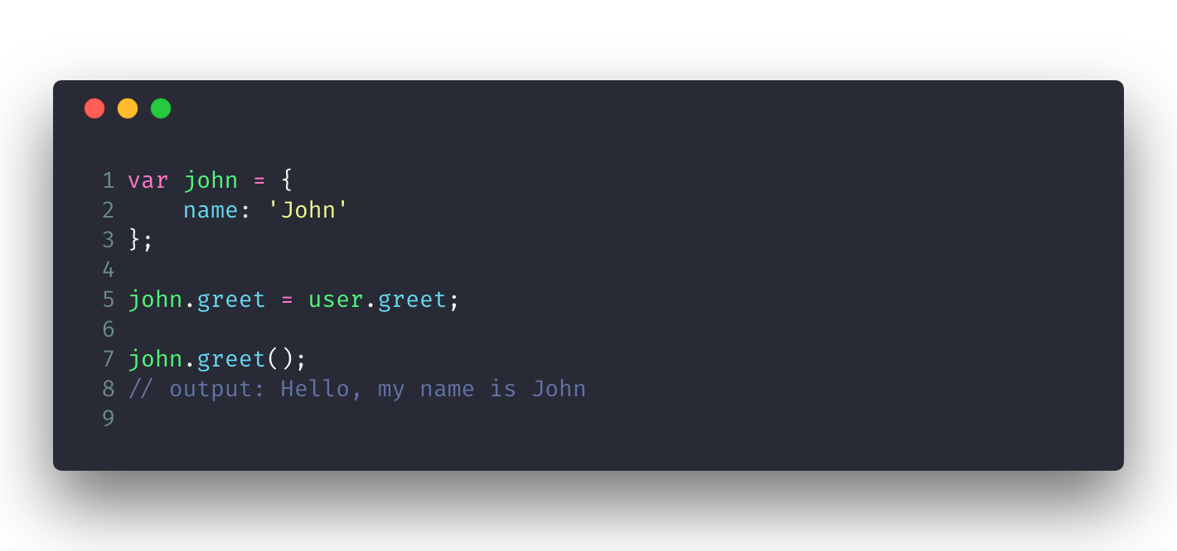
What is this?

Slide 58
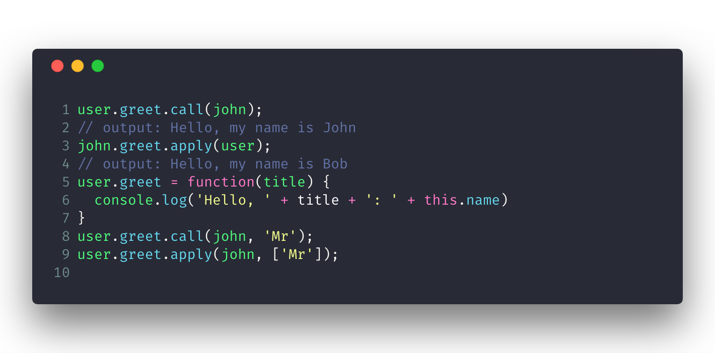
call(), apply(), and bind()

Slide 59
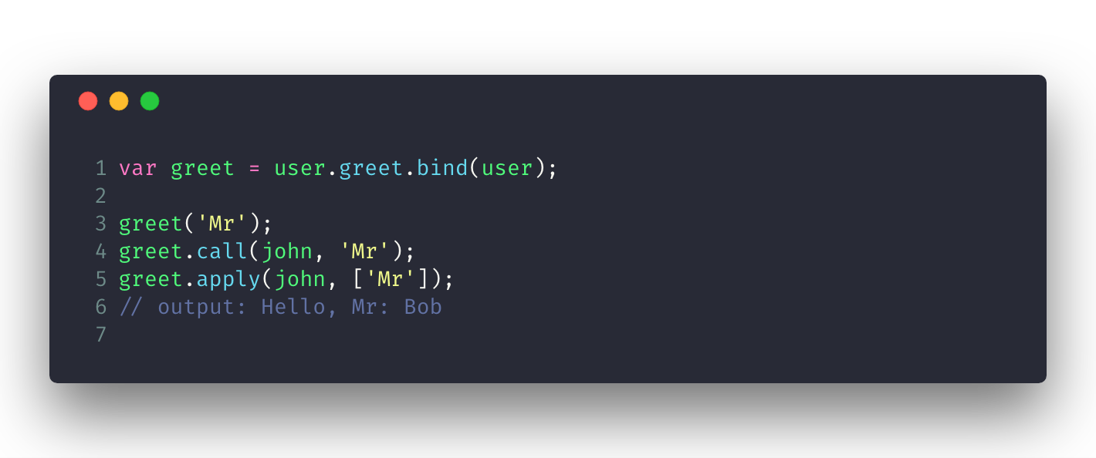
call(), apply(), and bind()

Slide 60
Higher-Order Function
Functions that operate on other functions, either by taking them as arguments or by returning them, are called higher-order functions.

Slide 61
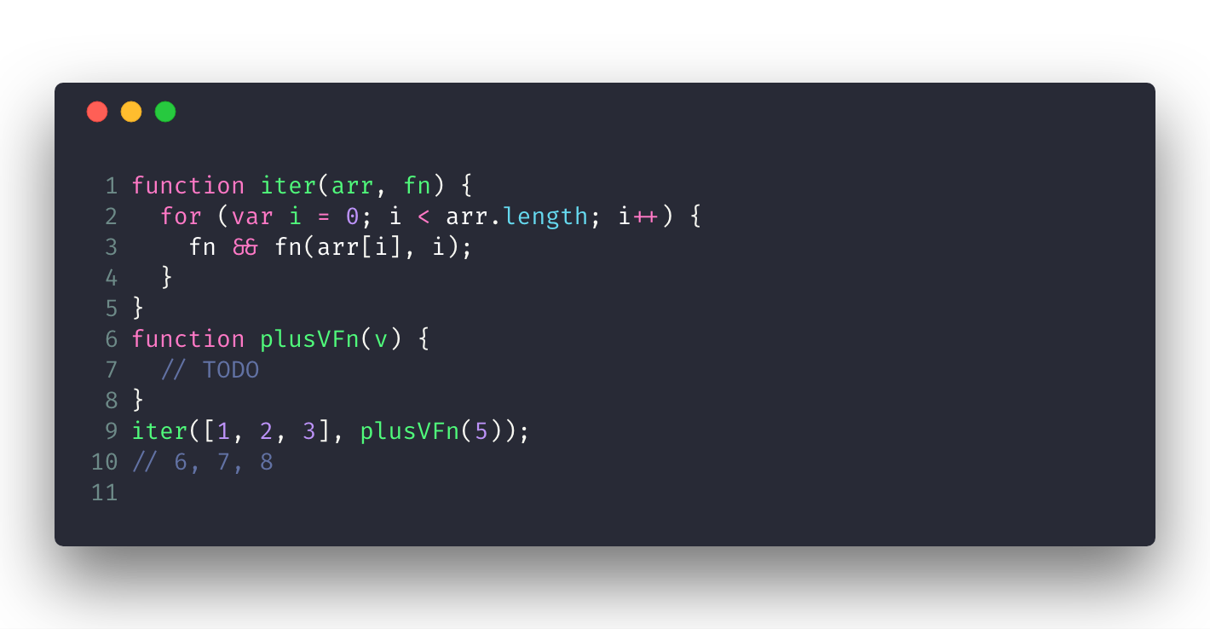
Higher-Order Function

Slide 62
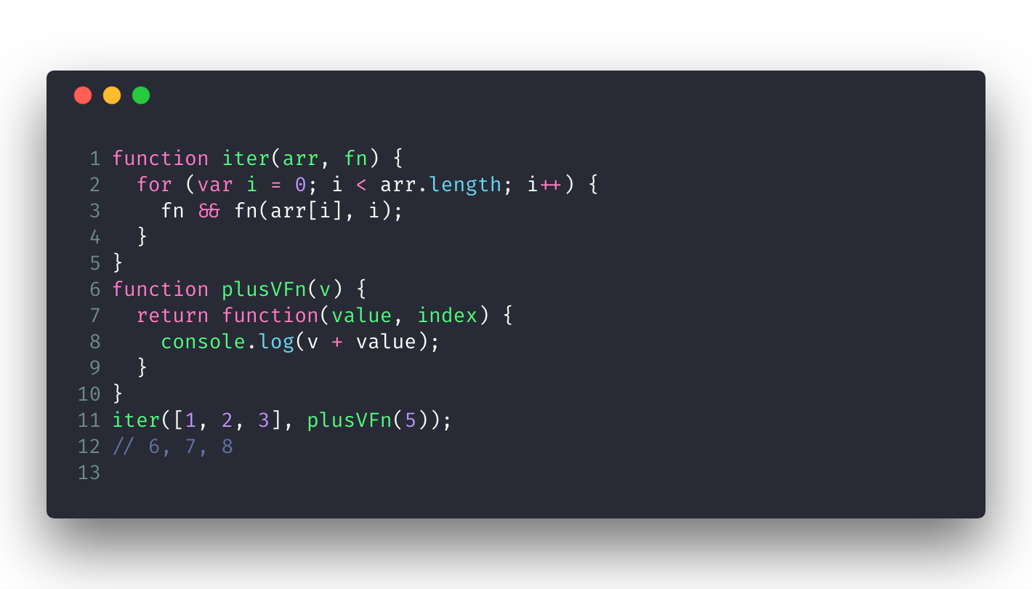
Higher-Order Function

Slide 63
Object/Class
All objects in JavaScript are maps (dictionaries) from strings to values.
A (key, value) entry in an object is called a property.
The key of a property is always a text string (number).
The value of a property can be any JavaScript value, including a function.
Methods are properties whose values are functions.

Slide 64
Object/Class

Slide 65
Object/Class
Pitfall: Losing this When Extracting a Method
Pitfall: Functions Inside Methods Shadow this

Slide 66
Object/Class
The Prototype Relationship Between Objects

Slide 67
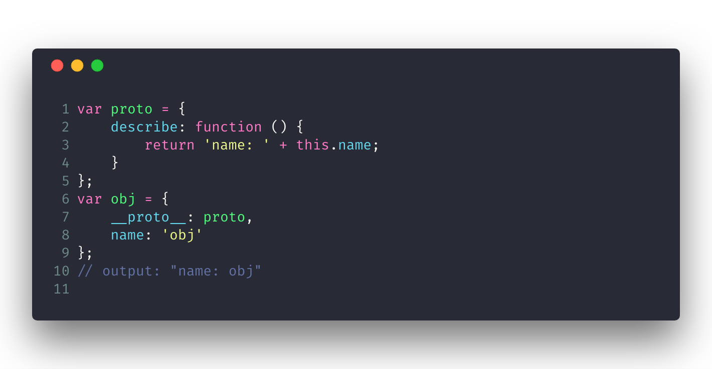
Object/Class
The Prototype Relationship Between Objects

Slide 68
Object/Class
Constructors:

Slide 69
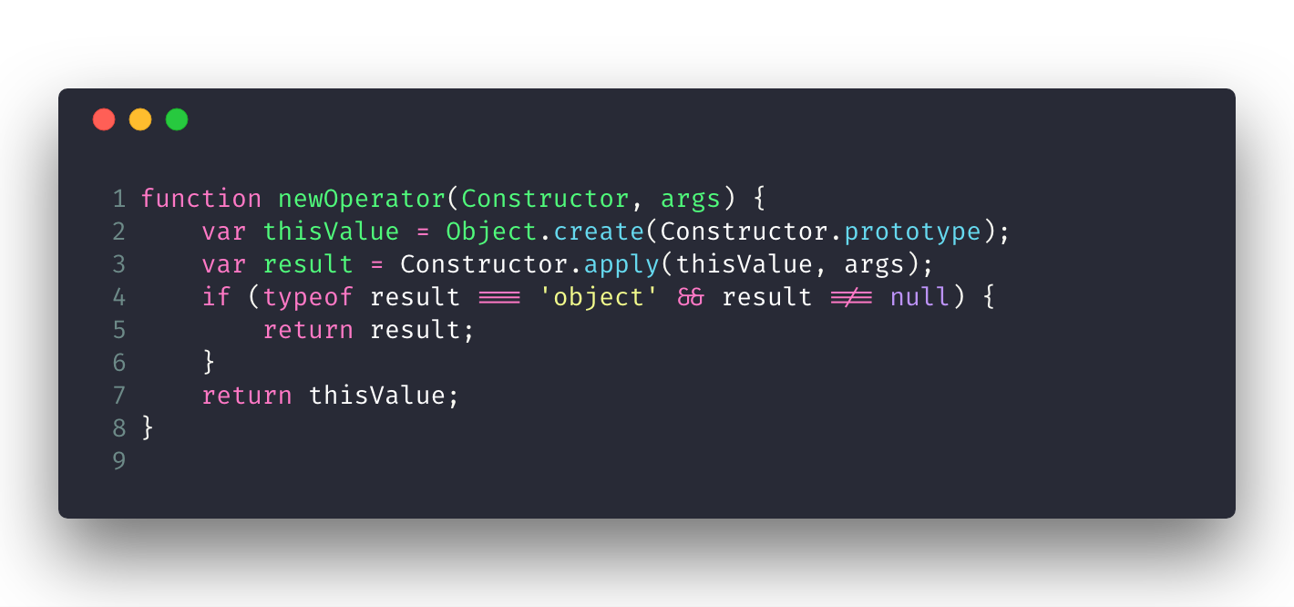
Object/Class
The new Operator Implemented in JavaScript:

Slide 70
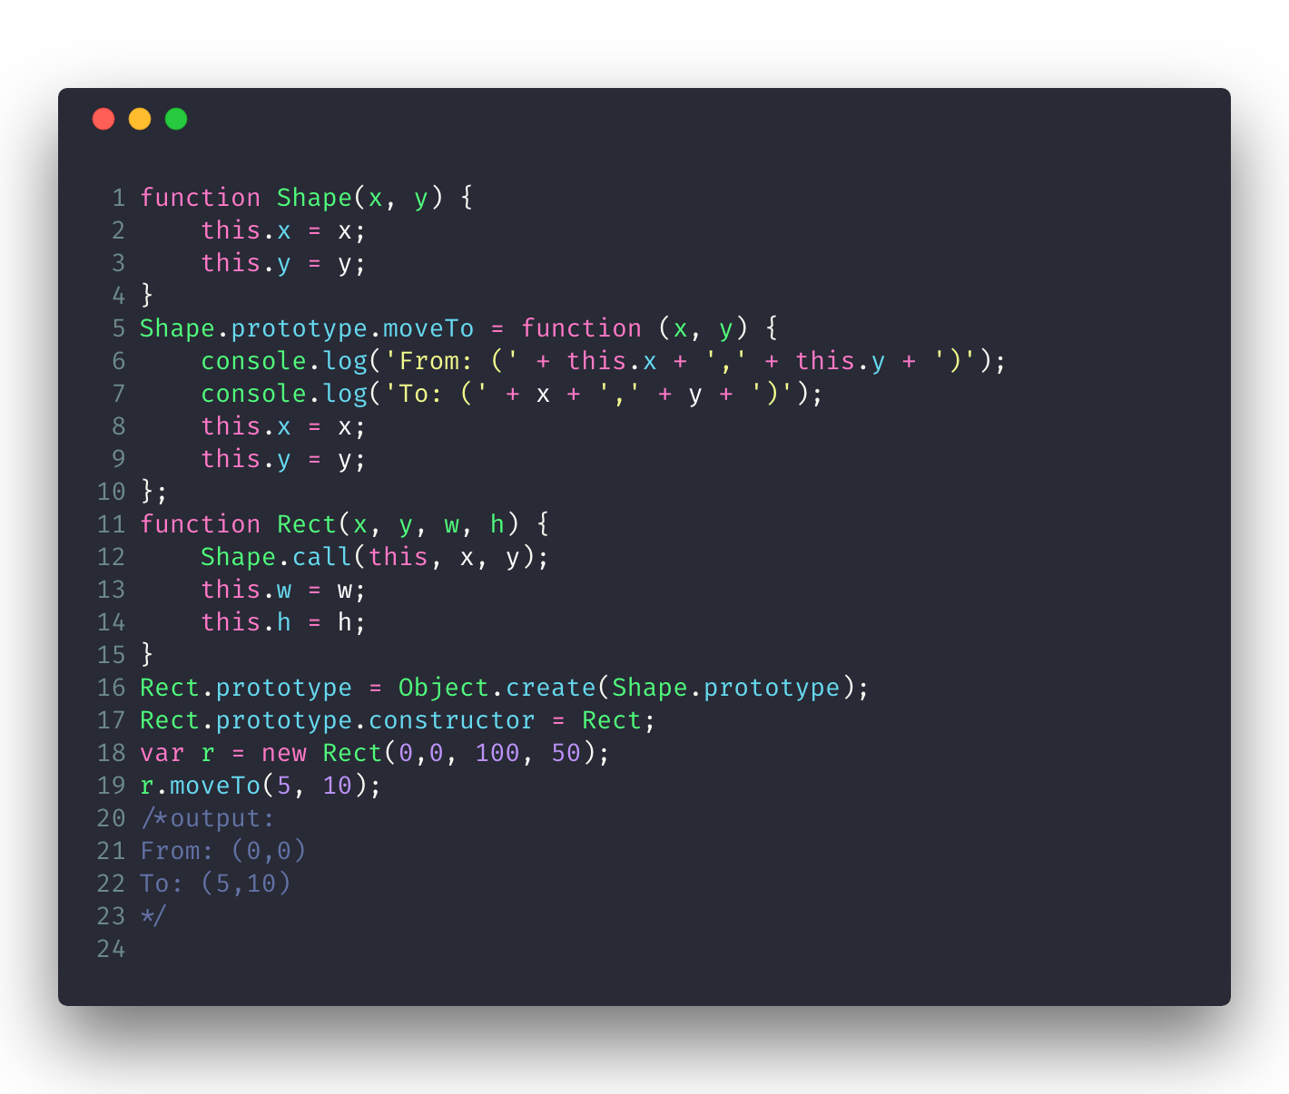
Object/Class
Inheritance in JavaScript:

Slide 71
Object/Class
Constructors—Factories for Instances:
A constructor function (short: constructor) helps with producing objects that are similar in some way. It is a normal function, but it is named, set up, and invoked differently. This section explains how constructors work. They correspond to classes in other languages.

Slide 72
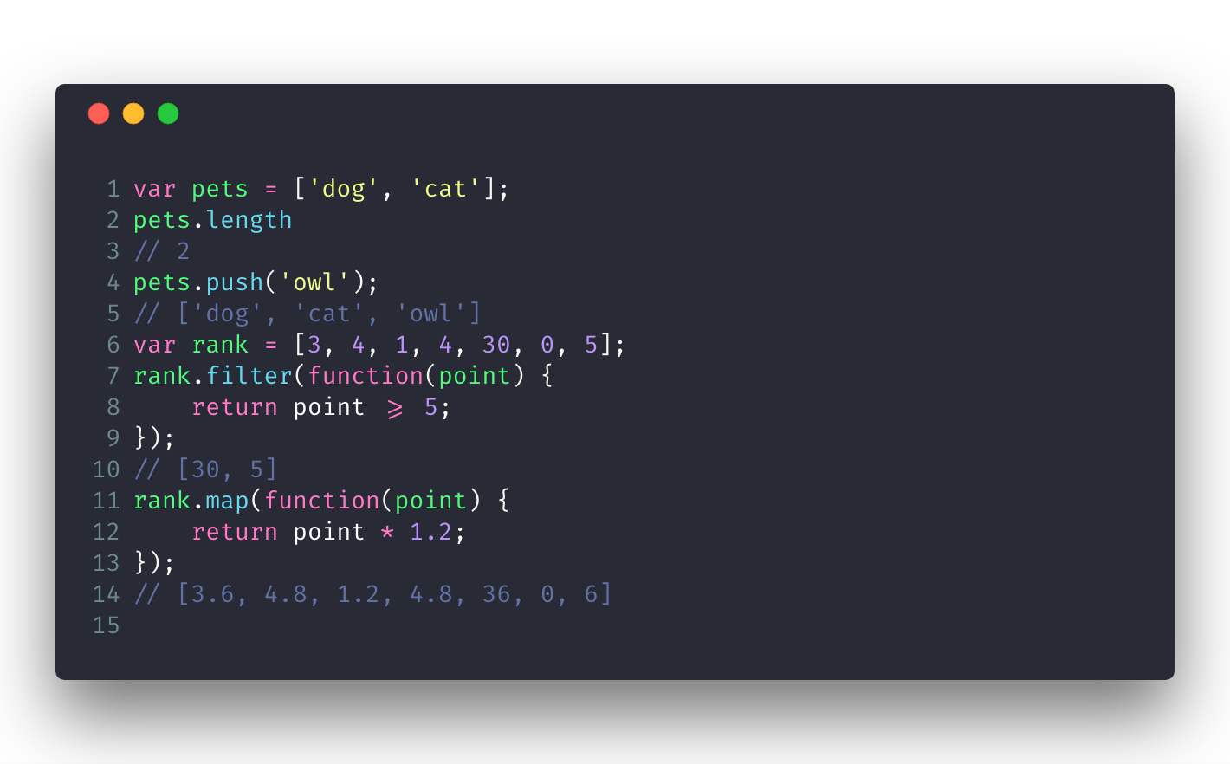
Array
https://developer.mozilla.org/en-US/docs/Web/JavaScript/Reference/Global_Objects/Array

